Slide 1
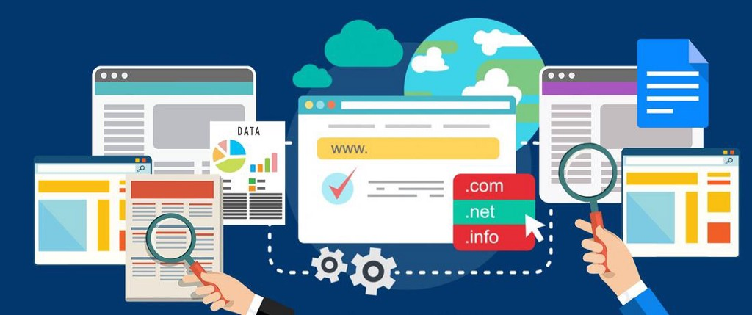
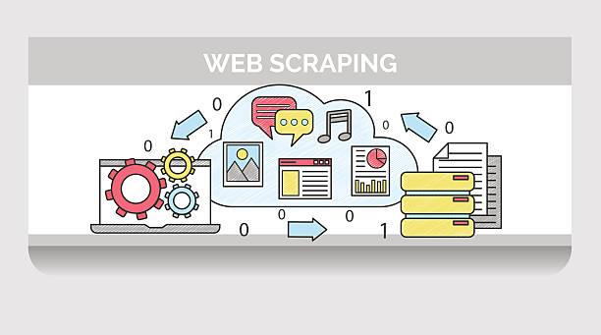
Web Scraping
Pavitra Mohandas
MS CS - UT Austin
Reach out to me in canvas, pavitra.mohandas@utexas.edu
Office Hours - MW 5:00 - 6:30 pm (SAC 2nd Floor)

Slide 2
Topics to be covered in Demo
What’s Web Scraping
Why Web Scraping Matters
Selenium: Empowering Scraping
Python: Your Scraping Companion
Google Colab: Convenient Playground
Demo of Web Scraping
Useful links and resources to look into

Slide 3
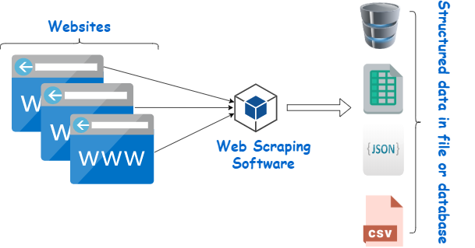
What's Web Scraping?
Automated extraction of data from websites.
Using tools to navigate web pages and collect information.
Enables large-scale data collection efficiently.
Source of image - .www.google.com

Slide 4
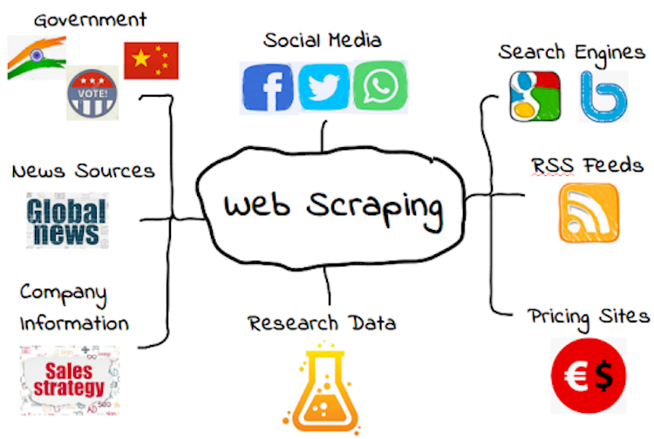
Why Web Scraping Matters
Vital for business insights and competitive analysis.
Essential in research and data-driven decision-making.
Example ->
Business Insights: Collecting competitor pricing data.
Research: Gathering articles for sentiment analysis.
Source of image - .www.google.com

Slide 5
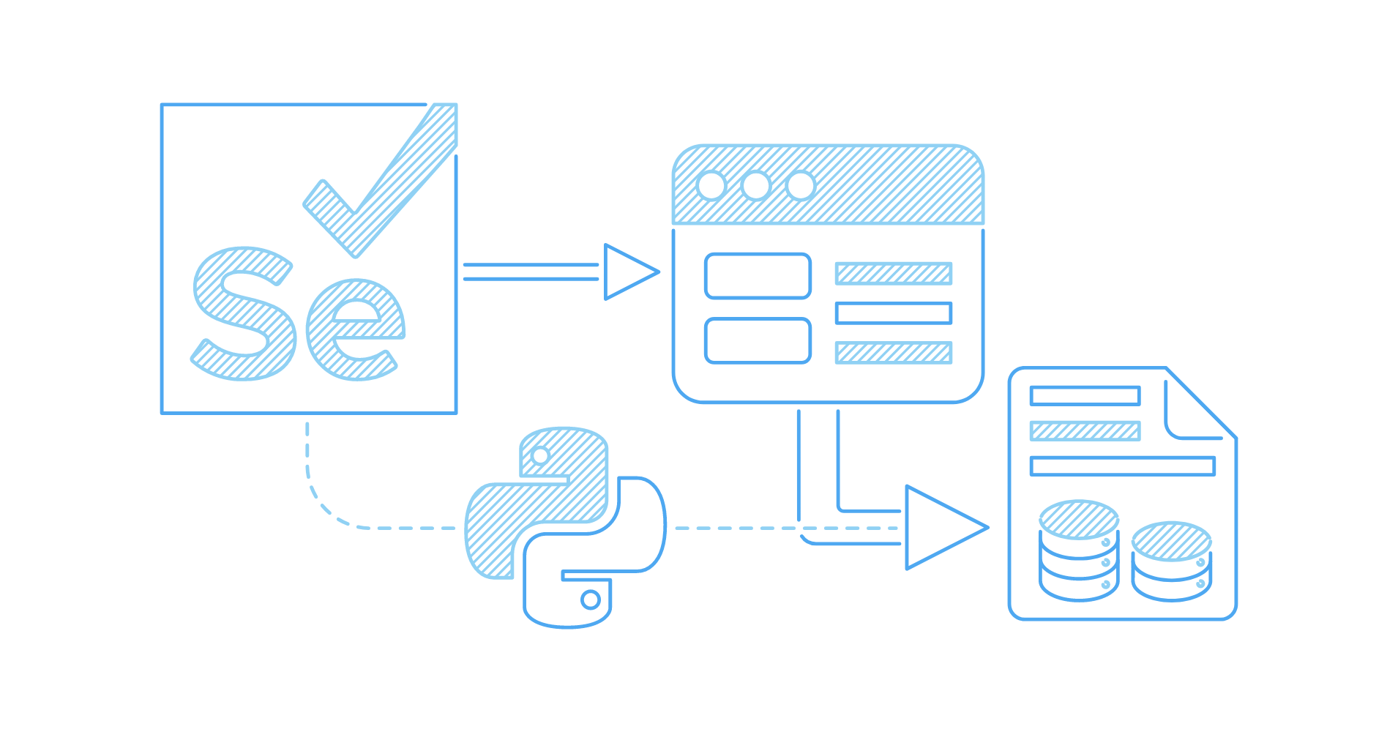
Selenium: Empowering Scraping
Tool for automating web application tasks.
Interacts with websites like a user would.
Navigates pages, interacts with elements, and extracts data.
Suited for dynamic websites built with JavaScript.
Source of image - .www.google.com

Slide 6
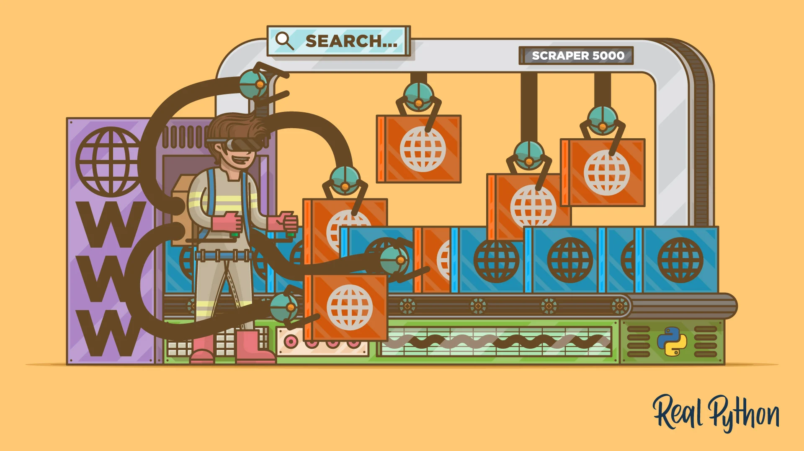
Python: Your Scraping Companion
Popular programming language for web scraping.
Libraries like BeautifulSoup and Requests complement Selenium.
Parses HTML, makes HTTP requests, and extracts data.
Suitable for both beginners and experienced developers.
Source of image - https://realpython.com/

Slide 7

Google Colab: Convenient Playground
Online Jupyter Notebook platform by Google.
No local setup required, runs in the cloud.
Integrates seamlessly with Selenium, Beautiful Soup, etc.
Ideal for experimenting with web scraping techniques.
Source of image - https://geekflare.com/google-colab/

Slide 8

Demo of Scraping Data from single page - Selenium

Slide 9
Demo of Scraping Data from if there is “Load More” Button

Slide 10
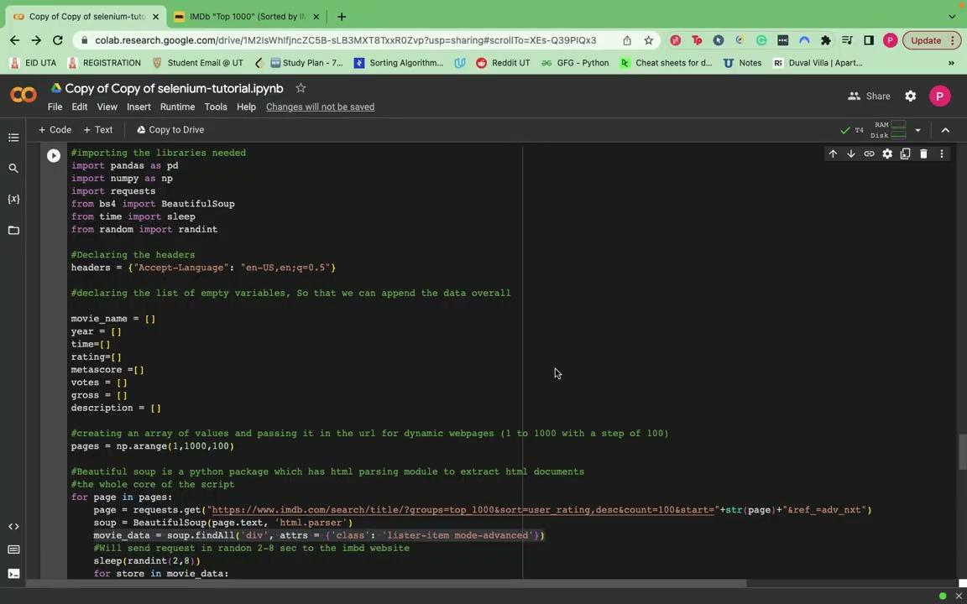
Demo of Scraping Data from Multiple Pages

Slide 11
Demo of Scraping Data from Multiple Pages
Other things to cover from Demo
I saw in code that there was else in few lines of code. What exactly does it do?
The else part is when, you do not have data for a field and you include some dummy data rather than leaving it empty.
Why should we do that?
Again it’s a programmer’s choice and a decision to make.

Slide 12
Useful links and resources to look into
Selenium Documentation: Learn about Selenium's features.
https://www.selenium.dev/documentation/
Python + Selenium tutorials
https://www.youtube.com/watch?v=Xjv1sY630Uc&list=PLzMcBGfZo4-n40rB1XaJ0ak1bemvlqumQ
Beautiful Soup Documentation: Understand HTML parsing.
https://www.crummy.com/software/BeautifulSoup/bs4/doc/
Introduction to Google Colab: Get started with Colab.
https://colab.research.google.com/notebooks/intro.ipynb
Web Scraping with Python: Comprehensive scraping tutorial.
https://realpython.com/beautiful-soup-web-scraper-python/

